Slide 1

Department of Computer Science & Engineering
Acharya Institute of Technology
Soladevanahalli, Bengaluru 560 107
Project Phase 1 (BCS685) Synopsis Presentation on
AI-Enabled Smart Village Service Portal Using MERN Stack
Presented by
Group No | Name | USN
18 | Darshan M | 1AY23CS065
 | Gajula Harshith | 1AY23CS077
 | M Shankarlingeshwar | 1AY23CS107
 | Shailaja | 1AY23CS166
Guide Name:Mrs. Shrutika C Rampure Designation: Assistant Professor
Dept of CSE

Slide 2
AI-Enabled Smart Village Service Portal Using MERN Stack
1. Introduction
2. Literature Survey
3. Problem statement and Objectives
4. Proposed Methodology
5. Deliverables and Impact
6. Individual Responsibilities among the group members
7. Gantt Chart
8. Design specification
9. References.
Dept of CSE

Slide 3
1. INTRODUCTION
• Definition – AI-Enabled Digital Gram Panchayat Services System is a smart e-governance platform that provides village services online through a web application.
• Village Service Challenges – Villagers often face difficulties in reporting complaints, checking scheme eligibility, accessing village information, and receiving timely updates due to manual and disconnected systems.
• Digital Service Approach Users can upload issue images, submit complaints, check schemes, and track request status anytime through the portal.
• Technology Used – Developed using MERN Stack (MongoDB, Express.js, React.js, Node.js) with AI features using Python and Scikit-learn.
• Need & Smart Services – Traditional complaint systems are slow; AI helps automate complaint classification, chatbot support, notifications, and faster issue resolution.
Dept of CSE

Slide 4
2. LITERATURE SURVEY
S.N | Paper title | Publication details | Name of the Authors | Findings/Technical ideas discussed in the paper | Observations/Shortfalls and solution provided in the proposed methodology
1 | E-Gram Panchayat | IEEE NKCon, 2023 | Keerti Patil et al. | Web app for services, schemes, admin modules, status tracking | No AI support → Add chatbot, updates, multilingual access
2 | CitySolution: A Complaining Task Distributive Mobile Application for Smart City Corporation using Deep Learning | arXiv, 2024 | Farhatun Shama, Abdul Aziz, Lamisa Bintee Mizan Deya | Deep learning complaint classification, image upload, authority monitoring | Limited to complaints → Add schemes, transparency dashboard, chatbot
Dept of CSE

Slide 5
2. LITERATURE SURVEY
S.N | Paper title | Publication details | Name of the Authors | Findings/Technical ideas discussed in the paper | Observations/Shortfalls and solution provided in the proposed methodology
3 | Digital Gram Panchayat | IJRASET, 2024 | Parade et al. | Digital Panchayat services, grievance handling, transparency | Limited smart automation → Add AI complaint classification and eligibility checker
4 | The Influence of Institutional Capacity on the Implementation of Smart Villages in Village Development | Indonesian Journal of Social Research, 2025 | Rita Rahmawati et al. | Smart village implementation, digital participation, village development | Infra and network issues → Add centralized smart portal and alerts
Dept of CSE

Slide 6
2. LITERATURE SURVEY
S.N | Paper title | Publication details | Name of the Authors | Findings/Technical ideas discussed in the paper | Observations/Shortfalls and solution provided in the proposed methodology
5 | GramConnect: A Digital Platform for Gram Panchayat Services with Chatbot Support | IEEE IC3ET, 2026 | Bhushan Naikwade et al. | Chatbot support, complaint portal, multilingual services, alerts | Weak analytics → Add transparency dashboard and AI-based suggestions
Dept of CSE

Slide 7
3. PROBLEM STATEMENT & OBJECTIVES
Problem Statement
• Villagers face difficulties in reporting local issues, accessing government schemes, and obtaining public service information due to manual and disconnected systems.
Objectives
• Develop a smart village service portal where users can upload complaints and access village-related services online.
• Develop a portal where users can check eligibility, upload required documents, and receive personalized recommendations for applicable government schemes online.
• Develop a transparency dashboard where villagers can view ongoing projects, budgets, completed works, and public service updates online.
• Develop a smart communication system with chatbot and notification support to provide complaint updates, announcements, and village information to users.
Dept of CSE

Slide 8
4. PROPOSED METHODOLOGY
Users register and log in to access the smart village portal.
The portal provides multiple services such as complaint submission, scheme recommendation, announcements, dashboard access, chatbot support, and document upload.
The system validates user details, uploaded files, complaints, and scheme information before processing.
AI modules categorize complaints, recommend suitable schemes, handle chatbot queries, and generate notifications.
MongoDB stores complaints, user records, applications, notifications, and village-related information securely.
Admin users monitor complaints, verify applications, update village projects, and publish announcements through the admin dashboard.
Users receive complaint status updates, scheme eligibility results, announcements, and chatbot responses through the portal.
Dept of CSE

Slide 9
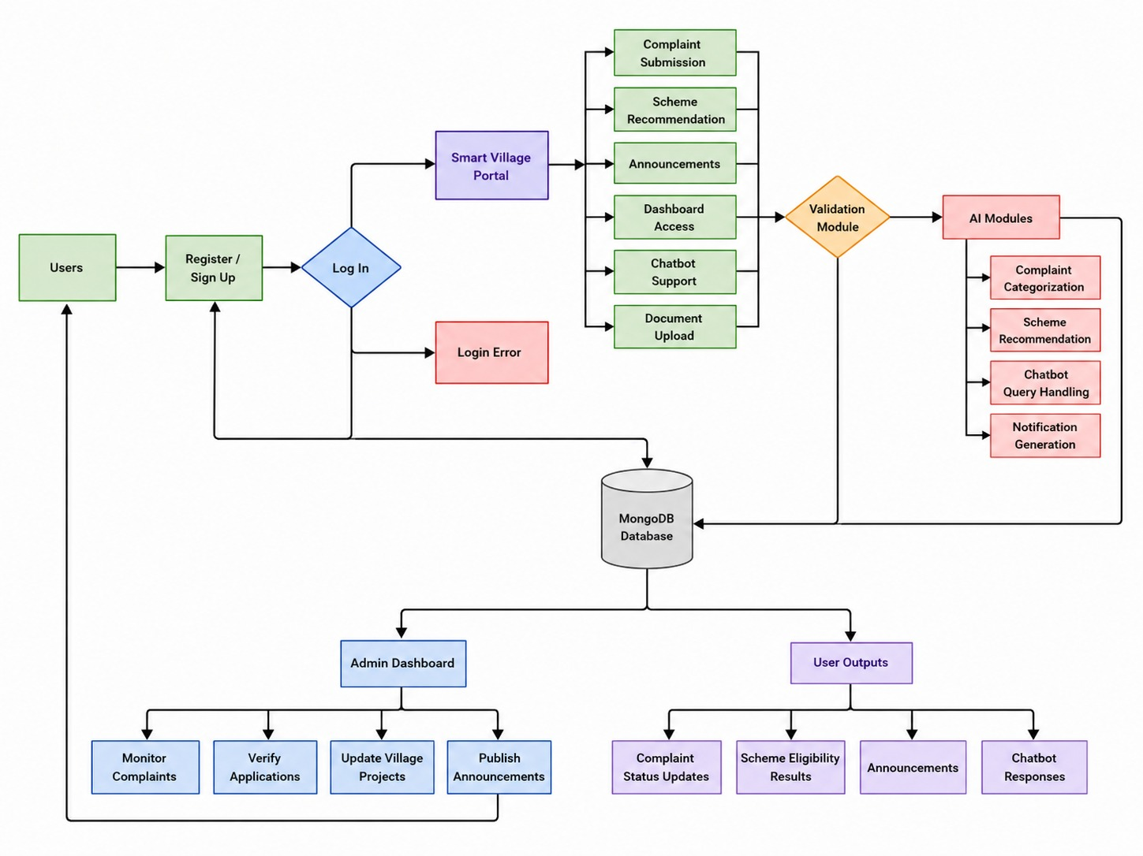
4. PROPOSED METHODOLOGY
Dept of CSE

Slide 10
5. DELIVERABLES & IMPACT
Deliverables:
• AI-enabled Smart Village Service portal prototype.
• Online modules for complaints, schemes, village notices, and transparency.
• Web application using MERN Stack for villagers and admin users.
• Admin dashboard for monitoring complaints and updating status.
• Complete project documentation and system report.
Impact:
• Improves village problem reporting through digital access.
• Reduces manual work and complaint processing delays.
• Increases transparency between villagers and admin users.
• Supports smart village services using AI and automation.
• Saves time through online tracking and notification updates.
Dept of CSE

Slide 11
6. GROUP MEMBERS INDIVIDUAL RESPONSIBLITIES
• Member 1 (Harshith) – Frontend Development
Develops the user interface using React.js, designs pages for user registration, login, issue reporting, and status tracking.
• Member 2 (Darshan)– Backend Development
Implements Node.js and Express APIs, handles server logic, authentication, and communication between frontend and database.
• Member 3 (Shailaja)– Database Management
Designs and manages MongoDB database, stores user data, applications, complaints, and service records.
• Member 4 (Shankar)– AI Model Development & Integration
Develops AI chatbot, voice input, and smart automation using Python/Scikit-learn and integrates it with the backend system.
Dept of CSE

Slide 12
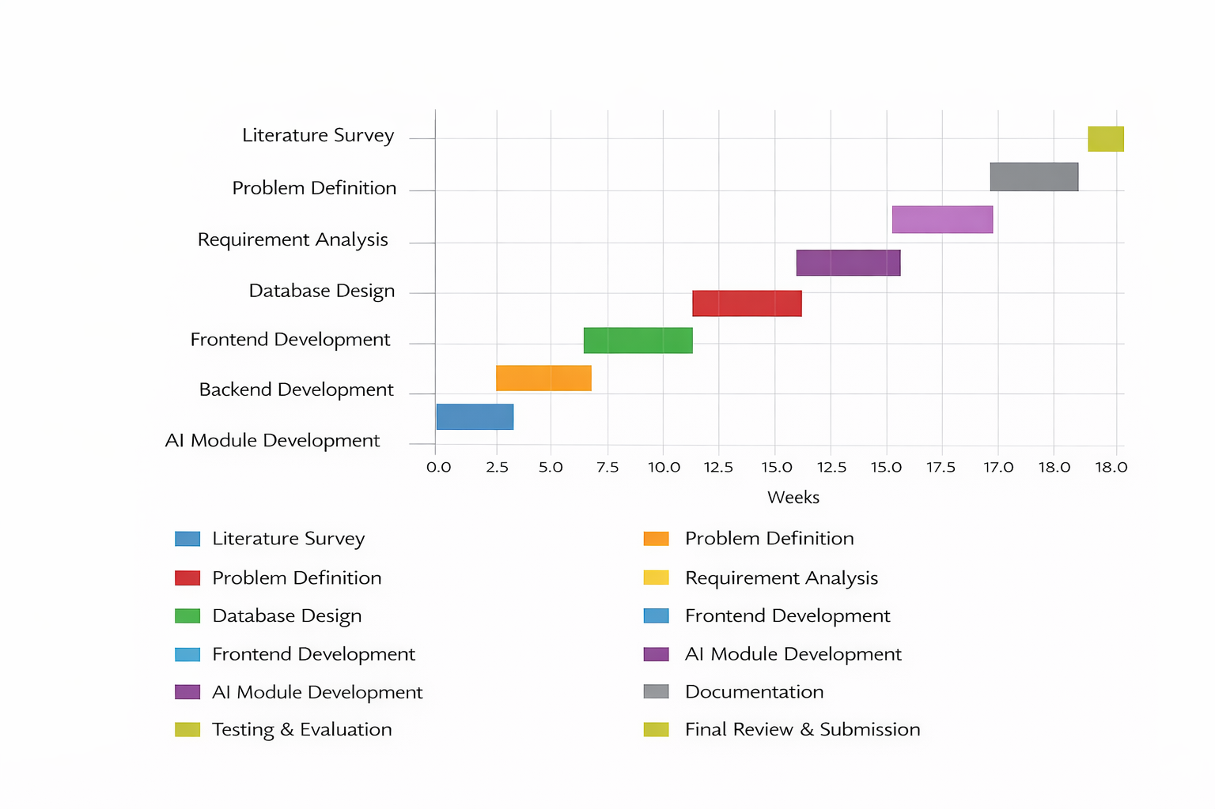
7.Gantt Chart
Dept of CSE

Slide 13
8.Design
System Architecture
• The system follows a three-tier architecture with Frontend, Backend, and Database layers.
• React.js is used to build a responsive and user-friendly interface for villagers and admins.
• Node.js and Express.js manage backend APIs and server-side processing.
• MongoDB is used to securely store user details, complaints, applications, and records.
• Python-based AI modules provide chatbot support and smart automation features.
• REST APIs are used for secure communication between frontend and backend.
Dept of CSE

Slide 14
8.Design
Module Design
User Module
• User registration and login • Submit complaints and track status • Check scheme eligibility and upload documents • View announcements, village information, and project updates
Admin Module
• Verify scheme applications and documents • Manage complaints and user requests • Update complaint/application status and announcements • Monitor transparency dashboard and village projects
Dept of CSE

Slide 15
8.Design
Module Design
AI Module
• Chatbot support for user queries • Smart scheme recommendation system • Complaint categorization and notification support
Database Module
• Stores user data, complaints, and applications • Maintains scheme and complaint history • Provides secure data management and retrieval
Dept of CSE

Slide 16
9. REFERENCES
• [1] Keerti Patil, et al., “E-Gram Panchayat,” IEEE NKCon, 2023.
• [2] Farhatun Shama, Abdul Aziz, Lamisa Bintee Mizan Deya, “CitySolution: A Complaining Task Distributive Mobile Application for Smart City Corporation using Deep Learning,” arXiv, 2024.
• [3] Parade, et al., “Digital Gram Panchayat,” IJRASET, 2024.
• [4] Rita Rahmawati, et al., “The Influence of Institutional Capacity on the Implementation of Smart Villages in Village Development,” Indonesian Journal of Social Research, 2025.
• [5] Bhushan Naikwade, et al., “GramConnect: A Digital Platform for Gram Panchayat Services with Chatbot Support,” IEEE IC3ET, 2026.
Dept of CSE

